Slide 1
Queuing Network
Dr. Sk. Md. Masudul Ahsan
Professor, Dept. of CSE, KUET

Slide 2
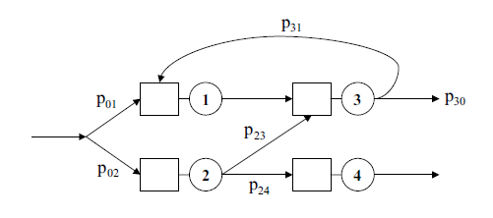
Queueing Networks
A queueing network is a system composed of several interconnected stations, each with a queue.
Customers, upon the completion of their service at a station, moves to another station for additional service or leave the system according some routing rules (deterministic or probabilistic).

Slide 3
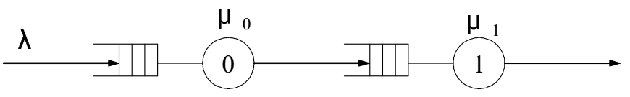
Exponential Queues in Series
In the queuing models that we have studied so far, a customer’s entire service time is spent with a single server.
In many situations the customer’s service is not complete until the customer has been served by more than one server.
2-stage tandem network with Independent Service Times
What the arrival process and rate at node 1 ?

Slide 4
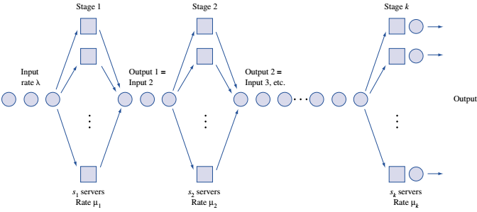
Exponential Queues in Series
k-stage series queuing system

Slide 5
Exponential Queues in Series Networks
Theorem
If
interarrival times for a series queuing system are exponential with rate λ,
service times for each stage i server are exponential, and
each stage has an infinite-capacity waiting room,
then interarrival times for arrivals to each stage of the queuing system are exponential with rate λ.

Slide 6
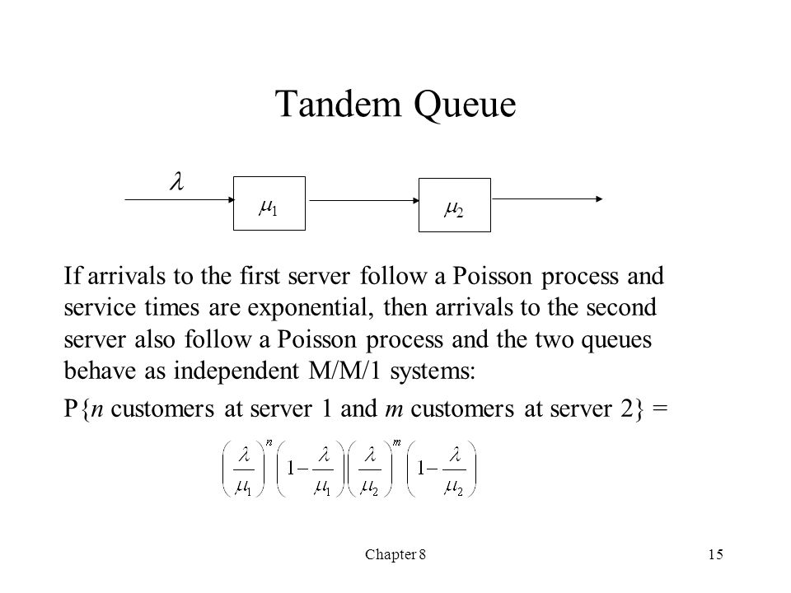

Slide 7
Tandem network of M/M/1 queues
M/M/1 queue, Poisson(λ) arrivals, exponential(μ) service
Equilibrium distribution
For a k queue tandem system with Poisson arrival and expo. service times
Jackson’s theorem:
Above formula is true when there are feedbacks among different queues
Each queue behaves as M/M/1 queue in isolation

Slide 8
Example: feed forward network of M/M/1 queues
1
4
3
2
5

Slide 9
Exponential Queues in Series Networks
The last two works in a car manufacturing process are installing the engine and putting on the tires. An average of 54 cars per hour arrive requiring these two tasks.
One worker is available to install the engine and can service an average of 60 cars per hour.
After the engine is installed, the car goes to the tire station and waits for its tires to be attached. Three workers serve at the tire station. Each works on one car at a time and can put tires on a car in an average of 3 minutes.
Both interarrival times and service times are exponential.
Determine the mean queue length at each work station.
Determine the total expected time that a car spends waiting for service

Slide 10


Exponential Queues in Series Networks
This is a series queuing system with
λ=54 cars per hour, s₁ = 1, μ₁ = 60 cars per hour,
s₂ = 3, and μ₂ = 20 cars per hour
Since λ < μ₁ and λ <3μ₂ , neither queue will “blow up,”
For stage 1 (engine), ρ = 54/60 = 0.9

Slide 11


Exponential Queues in Series Networks
For stage 2 (Tires), ρ = 54/(3*20) = 0.9
total expected waiting time is
0.15 +0.137 = 0.287 hour

Slide 12
Open Queuing Network
Jobs arrive from external sources, circulate, and eventually depart

Slide 13
Jackson Network Definition
1. All outside arrivals to each queuing station in the network must follow a Poisson process.
2. All service times must be exponentially distributed.
3. All queues must have unlimited capacity.
4. When a job leaves one station, the probability that it will go to another station is independent of its past history and is independent of the location of any other job.
In essence, a Jackson network is a collection of connected M/M/s queues with known parameters.

Slide 14
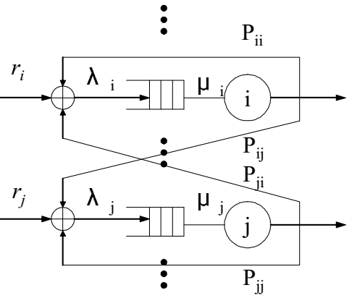
Jackson Network Definition
In essence, a Jackson network is a collection of connected M/M/s queues with known parameters.

Slide 15
Jackson’s Theorem
Each node is an independent queuing system with Poisson input determined by partitioning, merging and tandem queuing example.
Each node can be analyzed separately using M/M/1 or M/M/s model.
Mean delays at each node can be added to determine mean system (network) delays.

Slide 16
Computation of Input Rate
Let r_{i} = external arrival rate to station i = 1, . . . , k
P_{ij} = probability of going from station i to j in network
λ_{i} = total input to station i
In steady state there must be flow balance at each station.
k
m=1
λ_{i} = r_{i} + Σ P_{mi} λ_{m} , i = 1, . . . , k

Slide 17
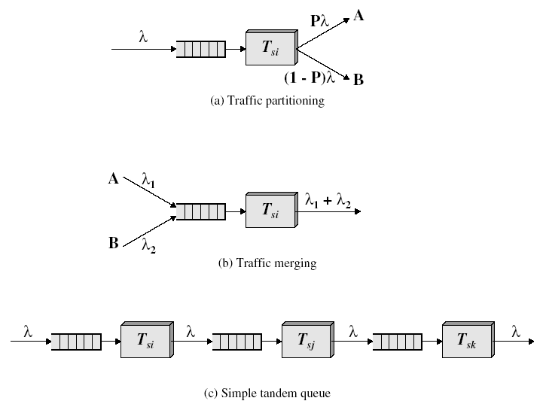
Element of a Queuing Network

Slide 18
Matrix Form of Computations
Property 1: Let P be the k × k probability matrix that describes the routing of units within a Jackson network, and let r_{i} denote the mean arrival rate of units going directly to station i from outside the system. Then
λ = r(I – P)^{–1}
where r = (r₁,…,r_{k}) give the external arrival rates into the various station; and l is the identity matrix,
λ_{i} is the net arrival rate into station i.
Note: Unlike the state-transition matrix used for Markov chains, the rows of the P matrix here need not sum to one; that is Σ_{j} P_{ij} ≤ 1

Slide 19
Simplification of Network
After the net rate into each node is known, the network can be decomposed and each node treated as if it were an independent queuing system with Poisson input.
Property 2: Consider a Jackson network comprising k nodes. Let N_{i} denote a random variable indicating the number of jobs at node i (the number in the queue plus the number in service). Then,
Pr{ N₁ = n₁, …, N_{m} = n_{m} } = Pr{ N₁ = n₁} × … × Pr{ N_{m} = n_{m} }
and
Pr{ N_{i} = n_{i}} for all n_{i} = 0, 1, … can be calculated using the equations for independent M/M/s seen previously.

Slide 20
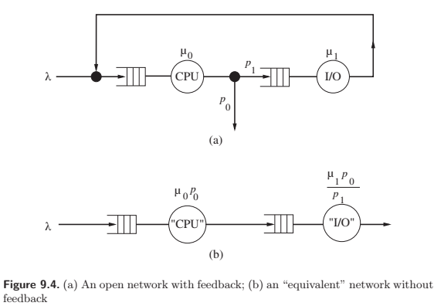

Slide 21










W=
For, M/M/1

Slide 22
Computation Center Example
A high performance computation center is composed of 3 work stations comprising: (1) input processors, (2) central computers, and (3) a print center.
All jobs submitted must first pass through an input processor for error checking before moving on to a central processor → 80% go through and 20% are rejected.
Of the jobs that pass through the central processor, 40% are routed to a printer.
Jobs arrive randomly at the computation center at an average rate of 10/min. To handle the load, each station may have several parallel processors.

Slide 23
Data for the Computation Center
We know from previous statistics that the time for the three steps have exponential distributions with means as follows:
10 seconds for an input processor
3 seconds for a central processor
70 seconds for a print processor
All queues are assumed to have unlimited capacity.
Goal
Model system as a Jackson network. Find the minimum number of processors of each type and compute the average time require for a job to pass through the system.

Slide 24
IOP
PrP
:
:
μP
:
:
IOP
PrP

Slide 25
Arrival Rate Computations
Using general equation:
With k = 3, r₁ = 10, p₁₂ = 0.8, p₂₃ = 0.4
we get:
λ₁ = 10
λ₂ = 0.8λ₁ = 8
λ₃ = 0.4λ₂ = 3.2

Slide 26
I/O Data for the Computation Center
Input
Central
System measure
processor
processor
Printer
External arrival rate, γ_{i}
10/min
0
0
Total arrival rate, λ_{i}
10/min
8/min
3.2/min
Service rate, μ_{i}
6/min
20/min
0.857/min
Minimum channels, s_{i}
2
1
4
Traffic intensity, ρ_{i}
0.833
0.400
0.933

Slide 27
Results for Computation Center
 | ρ | π₀
Input processor (M/M/2) | 0.833 | 10.976⁻¹ = 0.09
Central Processor (M/M/1) | 0.40 | 0.6
Printer (M/M/4) | 0.933 | ≈141⁻¹

Slide 28




Slide 29
Results for Computation Center
Input
Central
Printer
Measure
processor
processor
station
Total
Model
M/M/2
M/M/1
M/M/4
L_{q}
3.788
0.267
12.023
16.077
W_{q}
0.379
0.033
3.757
4.169
L_{s}
1.667
0.400
3.734
5.801
W_{s}
0.167
0.050
1.167
1.384

Slide 30
Problem
0.15
0.2
λ₁ =?
λ₂ =?
10
0.8
IOP
μP
μ₁ =?
μ₂ =?
0.1
6
λ₁ =10 + 0.1λ₁ + 0.2λ₂
λ₂ =6 + 0.8λ₁ + 0.15λ₂
λ₁ ≈ 15.21
Solves to
λ₂ ≈ 22.15

Slide 31
Problem
0.15
0.2
λ₁ =?
λ₂ =?
10
0.8
IOP
μP
μ₁ =?
μ₂ =?
0.1
6

Slide 32
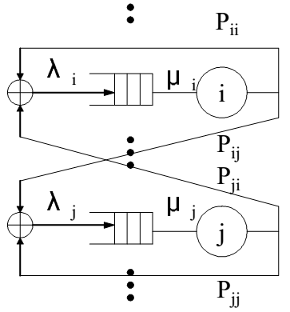
Closed Queuing Network
Fixed population of jobs circulate continuously and never leave
No arrivals from outside and no departures from the network
Example: CPU job scheduling problem
Since the number of jobs in the system is always constant, the distribution of jobs at different servers cannot be independent.
Simplest case, K customers circulating
among m queues
Each queue i has a server with exponentially
distributed service time μ_{I}
P_{ij} be the routing probability from Q_{i} to Q_{m}

Slide 33


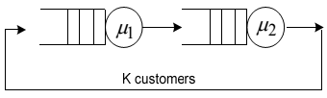
Closed Queuing Network
State of network at time t defined by
n =
or simply, = (n₁, n₂, …, n_{m})
which is m dimensional Markov process.
The state space S is determined by
For example, M = 2, K = 3
(n1, n2) state diagram
μ₂
μ₂
μ₂
0,3
1,2
2,1
3,0
μ₁
μ₁
μ₁

Slide 34

Closed Queuing Network
Gordon and Newell (1967) showed that any arbitrary closed networks of m-server queues with exponentially distributed service times also have a product form solution
The solution of the flow balance equation where
G(K, m) is a normalization constant so that given by

Slide 35
Closed Queuing Network
In order to determine G(K, m) we need λ_{i} ; ∀i
Flow conservation equation is
same as open network case without external arrivals or departures.
This equation have no unique solution. Fortunately, it turns out that we can use any solution to help us get steady-state probabilities
arrival rates are found relative to each other,
set λ₁= 1 or set λ₁ = μ₁ => ρ1 = 1

Slide 36

Closed Queuing Network
For example, consider the tandem queue model with K=3. with μ₁ = 1 and μ₂ = 2
From the diagram P₁₂ = P₂₁ = 1
i.e. λ₁= λ₂
State space S = { (0,3), (1,2), (2,1), (3,0) }
G(K, m) = G(3,2) =
choosing λ₁ = 1 λ₂ = 1 ρ₁ = 1 , ρ₂ = 0.5,
G(3,2) = 1.875

Slide 37

Closed Queuing Network
The computation of G( K, m) is difficult when the state space become large.
For a closed network of m queues with K customers the number of states is given by
Number of states =
For even small networks, this is large.
For example K = 9, m = 2 = 3,628,800 states
And, direct computation of G(K,m) is very tedious
One popular technique to determine is Buzen’s algorithm (also called the convolution algorithm ) G(K, m) = G(K, m -1) + ρ_{m}G(K -1, m)
With initial condition

Slide 38
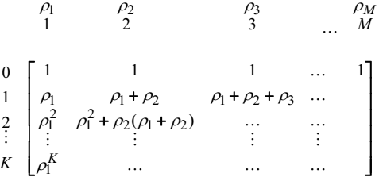
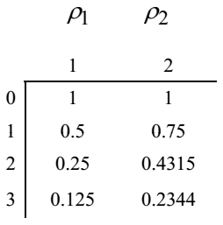

Closed Queuing Network
This can be computed in a simple tabular form
The i j element in the table is computed by taking the i,(j-1) element and adding ρ_{j} . (i -1, j ) element
For the two queue example.

Slide 39
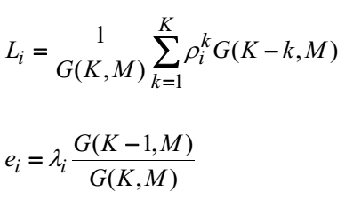


Closed Queuing Network
The performance measures can be written in terms of G( K, M)
L_{i} = average customer at queue i, e_{i} = effective arrival rate

Slide 40
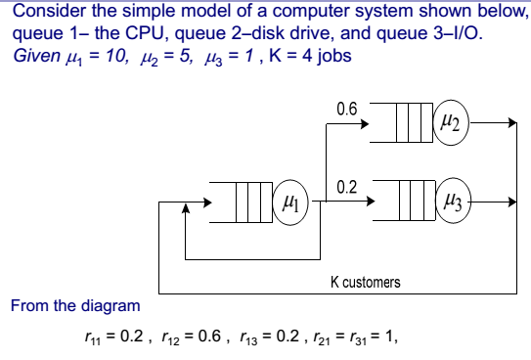
Example

Slide 41
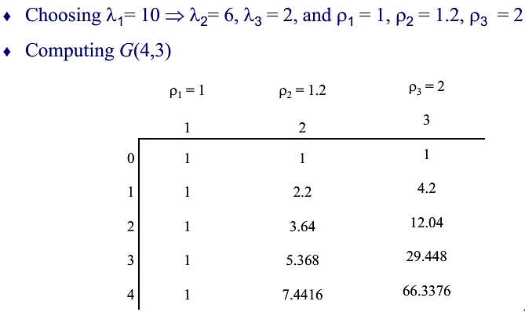
Example

Slide 42
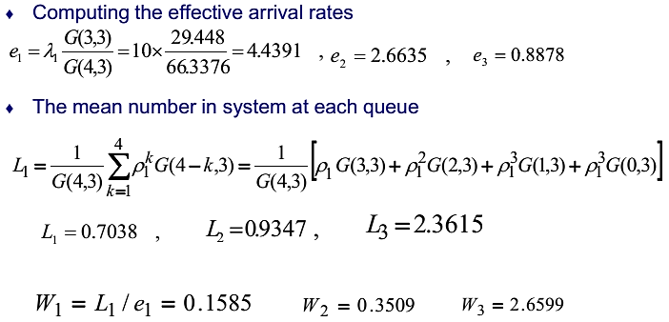
Example

